Slide 1
Project Introduction Analysis of Shared Parking Choice Behavior
Shuyan Chen
Xue Han

Slide 2
outline
Data description
Basic information ( including why/ when/ Where to collect data?)
Data dictionary (what kind of data are collected? Introduce each attribute, including each attribute’s meaning, value, range…)
Task description (What to do? How to do?)
What problem to solve? What model to build? What relationship to find?...

Slide 3
What’s shared parking?
A typical feature of commuting in an urban residential area is the daily ‘go out early and come back at dusk’ pattern .
Private parking slot owners drive their cars out to work in the morning and will be back in the evening, which makes their private parking slots idle during their out time.
These idle slots can be efficiently utilized to satisfy the parking demand of other drivers with flexible parking schedules for non-work activities (e.g., shopping, watch movies with optional times etc.).

Slide 4
Data description
Purpose: to study shared parking behavior and shared parking demand forecast
Dataset
Parking information data
Parking intention survey data
RPSP questionnaire
RPSP survey data

Slide 5
Data description
Parking information data
Collect the data from 3 parking lots in Nanjing Jiangning district.
① KingMo(景枫) : Commercial district
② PHOENIX CONTACT（菲尼克斯电器公司） : Office
③ 21st century modern city（21世纪现代城）: Residential district
Save as Parking Data.xlsx
②
①
③

Slide 6
Data description
Parking Data.xlsx:
Include parking time and capacity of each parking lot
Collect the parking data every 10 min in a day.
Duration | Drive in | Drive out | Total number | Change
 |  |  | 156
17:00-17:10 | 4 | 1 | 159 | 3
17:10-17:20 | 3 | 0 | 162 | 3
17:20-17:30 | 4 | 1 | 165 | 3
17:30-17:40 | 7 | 0 | 172 | 7
17:40-17:50 | 4 | 1 | 175 | 3
17:50-18:00 | 9 | 1 | 183 | 8
18:00-18:10 | 5 | 1 | 187 | 4
18:10-18:20 | 12 | 1 | 198 | 11
18:20-18:30 | 5 | 0 | 203 | 5
18:30-18:40 | 6 | 1 | 208 | 5
18:40-18:50 | 3 | 2 | 209 | 1
18:50-19:00 | 4 | 0 | 213 | 4
Duration: the duration of survey
Drive in: the quantity of cars drive into the parking lot in the duration
Drive out: the quantity of cars drive out of the parking lot in the duration
Total number: the quantity of cars in the parking lot in the duration
Change: the variable quantity of cars between current duration and last duration

Slide 7
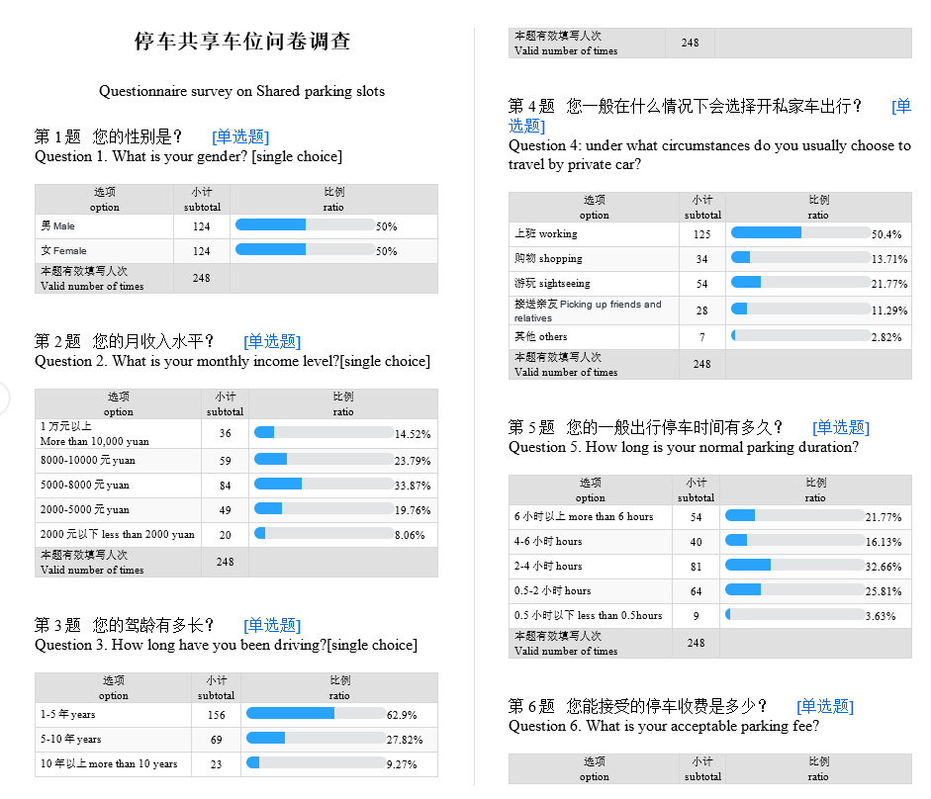
Data description
Parking intention survey data
Collected by questionnaire online
Save as Sheared parking RPSP questionnaire.docx.
The data is saved as RPSP survey data.xlsx
Each attribute is corresponding with the question in sheared parking RPSP questionnaire.
RP: Reveal Preference
SP: Stated Preference
No. | choice | Gender
1 | shared parking slot | 2
2 | normal parking slot | 2
3 | shared parking slot | 2
4 | normal parking slot | 2
5 | shared parking slot | 2
6 | shared parking slot | 1
7 | shared parking slot | 2
8 | shared parking slot | 1
9 | shared parking slot | 1
10 | shared parking slot | 2
11 | shared parking slot | 1
12 | shared parking slot | 1

Slide 8
Data description
Parking intention survey data
No. | choice | Gender | Income
1 | shared parking slot | 2 | 2
2 | normal parking slot | 2 | 3
3 | shared parking slot | 2 | 4
4 | normal parking slot | 2 | 4
5 | shared parking slot | 2 | 2
6 | shared parking slot | 1 | 2
7 | shared parking slot | 2 | 4
8 | shared parking slot | 1 | 1
9 | shared parking slot | 1 | 4
10 | shared parking slot | 2 | 4
11 | shared parking slot | 1 | 1
12 | shared parking slot | 1 | 2

Slide 9
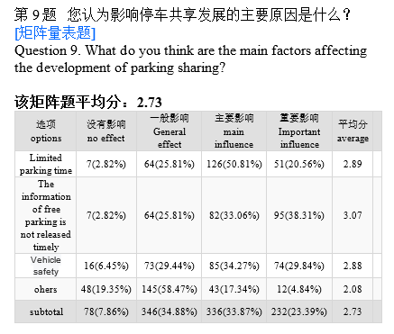
Data description
Parking intention survey data
mark from 1 to 4 points
No. | Q9
 | Parking time limited | Information of free parking is not released timely | Vehicle safety | Others | total
1 | 3 | 2 | 4 | 2 | 11
2 | 3 | 4 | 3 | 3 | 13
3 | 3 | 4 | 4 | 3 | 14
4 | 4 | 4 | 3 | 2 | 13
5 | 3 | 2 | 2 | 1 | 8
6 | 2 | 2 | 3 | 2 | 9
7 | 3 | 4 | 2 | 2 | 11
8 | 3 | 4 | 3 | 2 | 12
9 | 3 | 4 | 2 | 1 | 10
10 | 3 | 4 | 3 | 4 | 14
11 | 3 | 4 | 2 | 1 | 10

Slide 10
Parking intention survey data
Gender: 1--Male, 2--Female (related to Q1)
Income: 1--More than 10000 yuan, 2--[8000, 10000) yuan, 3--[5000, 8000), 4-[2000, 5000) yuan, 5--less than 2000 yuan (related to Q2)
Driving years: 1-- [1, 5] years, 2--[5,10] years, 3--more than 10 years (related to Q3)
Purpose: 1--working, 2--shopping, 3-- sightseeing, 4-- picking up friends and relatives, 5-- others (related to Q4)
Duration: 1--more than 6 h, 2-- [4, 6] h, 3-- [2, 4] h, 4-- [0.5, 2] h, 5-- less than 0.5 hours (related to Q5)
Fee: 1-- [15, 20] yuan/h, 2-- [10, 15] yuan/h, 3-- [5, 10] yuan/h, 4-- [2, 5] yuan/hour, 5-- less than 2 yuan/h (related to Q6)
Walking distance: 1-- [0, 5] min, 2-- [5, 10] min, 3-- [15, 20] min, 4-- more than 20 min (related to Q7)
Willing to rent or not: 1-- yes, 2-- no, 3-- not sure (related to Q8)
Parking time limited: mark from 1 to 4 points. No effect--1 point, General effect-- 2 points, Main influence-- 3 points, Important influence-- 4 points
Information limited: mark from 1 to 4 points. No effect--1 point, General effect-- 2 points, Main influence-- 3 points, Important influence-- 4 points
Vehicle safety: mark from 1 to 4 points. No effect--1 point, General effect-- 2 points, Main influence-- 3 points, Important influence-- 4 points
Others: mark from 1 to 4 points. No effect--1 point, General effect-- 2 points, Main influence-- 3 points, Important influence-- 4 points

Slide 11
Task - Demand Forecast for Shared Parking Slots
Stp. 1
Verify the feasibility of shared parking.
Analysis the temporal distribution differences between various parking purposes
Stp. 2
Analysis on influencing factors of residents' shared parking behavior
Stp.4
Optimize existing parking demand forecasting models according to the main influence factors
Dataset: Parking information data
Detect the main influencing factors and their influencing degree
Dataset: Parking intention survey data
Stp.3
Demand forecast of shared parking slots
Dataset: Parking intention survey data

Slide 12
Task - Demand Forecast for Shared Parking Slots
Methods to choose
Stp.2
A: Structural Equation Model (SEM)
B: Decision Tree
Methods to choose
Stp.3
1: Tikhonov Regularization/Ridge
C: Wrappers
3: Elastic Net
9: Gradient Boosting, XGBoost
11: Optional
D:Filters
E: Embedded (shrinkage)
F: Optional
10.Deep Learning
2: Lasso
4: Bayesian Regression
7. Logistic regression
5. Stochastic Gradient Descent
6. Isotonic Regression
8. Neural Networks
Note:
Choose the method form the boxes above to finish stp.2 and stp.3.
For example, A2, B4, C3…

Slide 13
Reference
P He, et al. "Parking Choice Behavior for Shared Parking Based on Parking Purposes." Applied Mechanics and Materials 743(2015): 439-444. DOI: 10.4028/www.scientific.net/amm.743.439
Su Xiu Xu , Meng Cheng , Xiang T.R. Kong , Hai Yang d, George Q. Huang, Private parking slot sharing. Transportation Research Part B, 93 (2016) 596–617 . https://doi.org/10.1016/j.trb.2016.08.017.
Jyun-KaiLiangTimoEccariusChung-ChengLu. Investigating factors that affect the intention to use shared parking: A case study of Taipei City. Transportation Research Part A: Policy and Practice. Volume 130, December 2019, Pages 799-812.
M. S. Smith, L. I. Urban, Shared Parking, second ed., Urban Land Institute,U.S.,2005.
K. Washbrook, W. Nghaider, M. Jaccard, Estimating commuter mode choice: A discrete choice analysis of the impact of road pricing and parking charges, Journal of Transportation. 33(2006)621–639.
S. An, J. Wang, Analysis and Modeling of Parking Behavior, Journal of Harbin Institute of Technology. 8(2),(2001)120-124.
A. H. Bin, Applying shared-parking turn-time(SPATT) model and geographic information system in the supply and demand analysis of parking space, Malaysian Journal of Real Estate.1(2),(2006)57-76.

